Slide 1

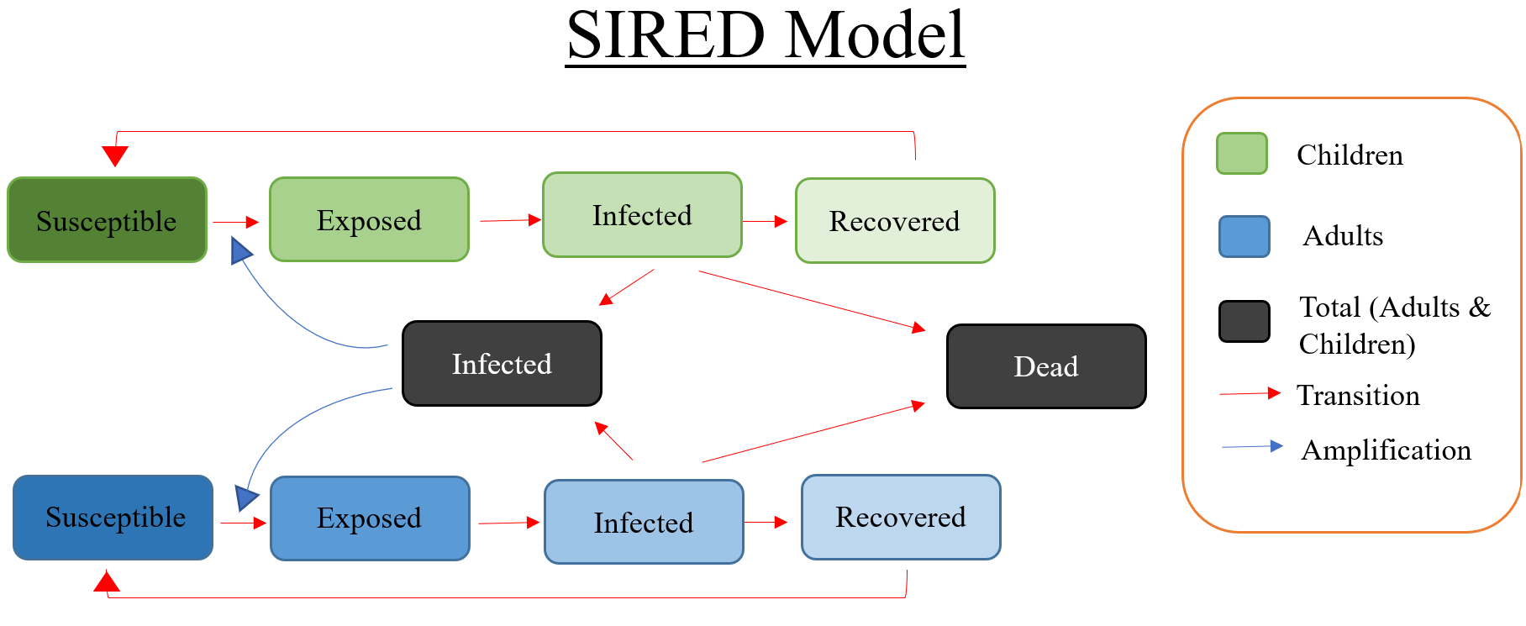
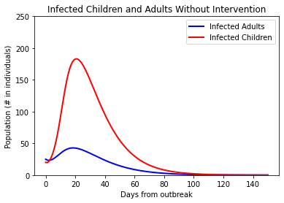
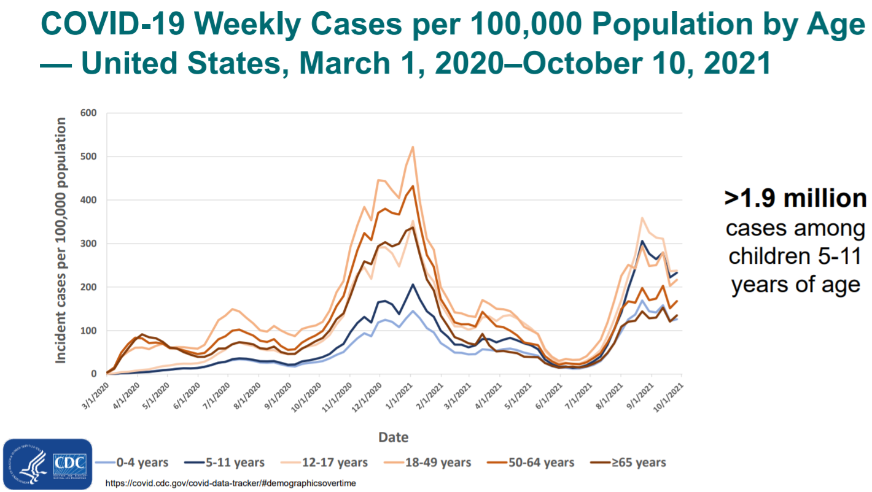
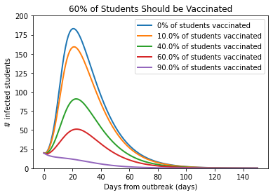
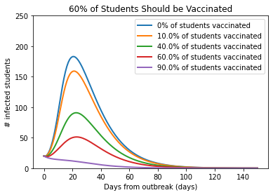
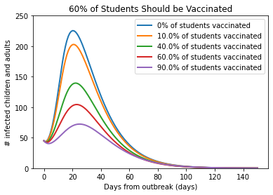
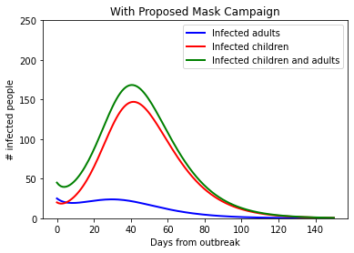
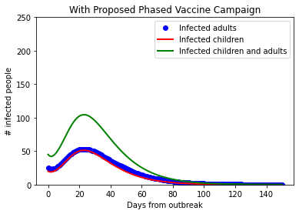
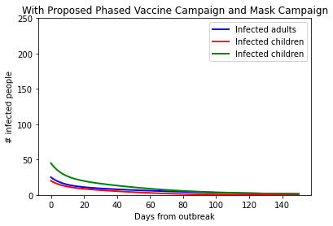
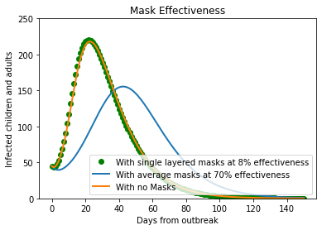
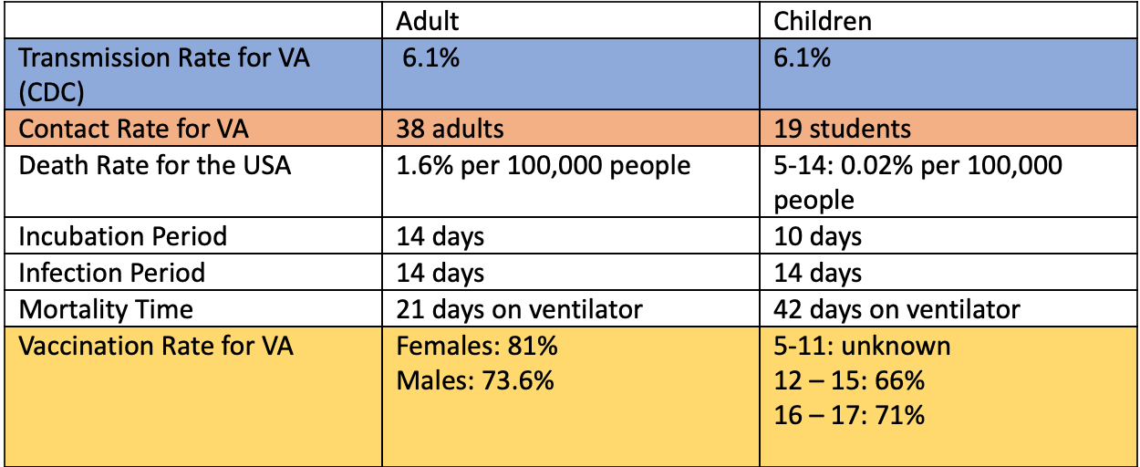
Effectiveness of mask wearing and vaccination in reducing COVID-19 spread in Virginia Schools
Sydney Tune, Mason Davis, Lauryn McCray, YoungJae Kim, Isaiah Medina
Department of Biology, Washington and Lee University
Objective:
Simulate a vaccination and masking campaign to see how vaccines and mask wearing effect virus spread in Virginian K-12 schools.
Identify and recommend the most effective type of mask, as well the type of campaign and reopening strategy that could be implemented in Virginian schools.
With Proposed Mask Campaign (left) and Vaccine Campaign (right)
Background:
Children under 16 high risk due to not being eligible for vaccines
Contact Rate for Adults = average elementary class size in VA x 2 classes per day
Contact Rate for Children = average number of classrooms / number of kids per elementary class in VA
Recommendations:
Vaccination policy: We recommend that schools should not fully reopen until 60% of their students are fully vaccinated.
Masking policy: We recommend that every student and adult wear double-layered cotton masks with an effectiveness of at least 70% .

